Slide 1
MODULE III

Slide 2
Syllabus
Polymorphism – Runtime and compile time polymorphism ,
overloading functions and operators, selecting friend member function for operator overloading , Virtual methods –
pure virtual methods – Abstract classes - applications of abstract classes.

Slide 3
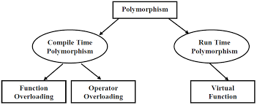
Polymorphism
Means one name , multiple forms.

Slide 4
Compile time polymorphism: -
The overloaded member functions are ‘selected’ for invoking by matching arguments, both type and number.
This information is known to the compiler at compile time and therefore is able to select appropriate function for a particular call at compile time itself.
This is called early binding , or static binding ,static linking or compile time polymorphism.

Slide 5
Function overloading
Using the same function name to create functions that perform a variety of different tasks.
Function overloading is the general concept of C++ which is not available with C.
The correct function to be invoked is determined by checking the number and type of arguments and not on the function type.
The languages Perl and Haskell overload by return type but other common OO languages does not support overloading by return type.
-- C++ also does not support overloading by return type. Its does overloading based on
types of parameters
number of parameters

Slide 6
Example of function overloading
int test() { }
int test(int a){ }
int test(double a){ }
Int test(int a, double b){ }
int test(int a){ }
double test(int b){ }
Compiler shows error in this case.

Slide 7
Example 1
int operate (int a, int b)
{
return (a*b);
}
double operate (double a, double b)
{
return (a/b);
}
int main ()
{
int x=5,y=2;
double n=5.0,m=2.0;
cout << operate (x,y) << '\n';
cout << operate (n,m) << '\n';
return 0;
}

Slide 8
How function calls are matched with overloaded functions
Making a call to an overloaded function results in one of three possible outcomes:
A match is found. The call is resolved to a particular overloaded function.
No match is found. The arguments cannot be matched to any overloaded function.
An ambiguous match is found. The arguments matched more than one overloaded function.
When an overloaded function is called, C++ goes through the following process to determine which version of the function will be called:
First, C++ tries to find an exact match. This is the case where the actual argument exactly matches the parameter type of one of the overloaded functions. For example:
void print(char *value);
void print(int value);
print(0); // exact match with print(int)
Although 0 could technically match print(char*) (as a null pointer), it exactly matches print(int). Thus print(int) is the best match available.

Slide 9
2) If no exact match is found, C++ tries to find a match through promotion. Certain types can be automatically promoted via internal type conversion to other types.
To summarize,
- Char, unsigned char, and short is promoted to an int.
- Unsigned short can be promoted to int or unsigned int, depending on the size of an int
- Float is promoted to double
For example:
void print(char *value);
void print(int value);
print('a'); // promoted to match print(int)
In this case, because there is no print(char), the char ‘a’ is promoted to an integer, which then matches print(int).

Slide 10
3) If no promotion is found, C++ tries to find a match through standard built in conversion.
Standard conversions include:
a. Any numeric type will match any other numeric type, including unsigned (eg. int to float)
b. Zero will match a pointer type and numeric type (eg. 0 to char*, or 0 to float)
For example:
struct Employee; // defined somewhere else
void print(float value);
void print(Employee value);
print('a'); // 'a' converted to match print(float)
In this case, because there is no print(char), and no print(int), the ‘a’ is converted to a float and matched with print(float).

Slide 11
Ambiguous matches
void print(unsigned int value);
void print(float value);
print('a');
print(0);
print(3.14159);
………………………………………………….
In the case of print('a'), C++ can not find an exact match. It tries promoting ‘a’ to an int, but there is no print(int) either. Using a standard conversion, it can convert ‘a’ to both an unsigned int and a floating point value. Because all standard conversions are considered equal, this is an ambiguous match.
b. print(0) is similar. 0 is an int, and there is no print(int). It matches both calls via standard conversion.
c. print(3.14159)
3.14159 is a double, and there is no print(double). Consequently, it matches both calls via standard conversion.
Ambiguous matches are considered as compile-time error.

Slide 12
4. If all the above steps fail, the compiler checks for user defined conversions in combination with promotions and built in conversions to find a unique match.
If that also fails, a message is displayed as no match is found.

Slide 13
Sample question
Write a program to find the volume of a cube , a sphere and a cylinder.
Use the concept of function overloading.

Slide 14
float vol(int,int);
float vol(float);
int vol(int);
int main()
{
int r,h,a;
float r1;
cout<<"Enter radius and height of a cylinder:";
cin>>r>>h;
cout<<"Enter side of cube:";
cin>>a;
cout<<"Enter radius of sphere:";
cin>>r1;
cout<<"Volume of cylinder is"<<vol(r,h);
cout<<"\nVolume of cube is"<<vol(a);
cout<<"\nVolume of sphere is"<<vol(r1);
return 0;
}
float vol(int r,int h)
{
return(3.14*r*r*h);
}
float vol(float r1)
{
return((4*3.14*r1*r1*r1)/3);
}
int vol(int a)
{
return(a*a*a);
}

Slide 15
Operator overloading
Operator overloading is an exciting feature of C++
The mechanism of giving special meaning to operator is called operator overloading.
We can overload all of the C++ operators except the following
Class member access operator( . , .*)
scope resolution operator (::)
Size of operator( sizeof())
Conditional operator (?)
By overloading , the original meaning of the operator is not lost.

Slide 16
The unary operators that can be overloaded includes the following:
! (logical NOT)
& (address-of)
~ (one's complement)
* (pointer dereference)
+ (unary plus)
- (unary negation)
++ (increment)
-- (decrement)

Slide 17
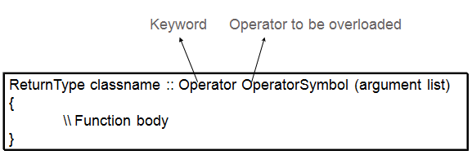
Syntax of operator overloading function
Implementing Operator Overloading
Operator overloading can be done by implementing a function which can be :
Member Function
Non-Member Function
Friend Function
Operator overloading function can be a member function if the Left operand is an Object of that class, but if the Left operand is different, then Operator overloading function must be a non-member function.
Operator overloading function can be made friend function if it needs access to the private and protected members of class.

Slide 18
Notes : -
A friend function will have only one argument for unary operators and two arguments for binary operators
A member function will have no arguments for unary and only one for binary operators.
This is because object used to invoke the member function is passed implicitly and is therefore available to the member function.
For a friend function, the arguments must be explicitly passed.

Slide 19
Restrictions
Following are some restrictions to be kept in mind while implementing operator overloading.
a. Precedence and Associativity of an operator cannot be changed.
b. Arity (numbers of Operands) cannot be changed. Unary operator remains unary, binary remains binary etc.
c. No new operators can be created, only existing operators can be overloaded.

Slide 20
unary operator overloading
The unary operators operate on a single operand and following are the examples of Unary operators:
The increment and decrement operator(++ and --)
The unary minus (-) operator.
The logical not (!) operator.
The unary operators operate on the object for which they were called and normally, this operator appears on the left side of the object, as in !obj, -obj, and ++obj.

Slide 21
Eg:- for unary op overloading – for decrementing and incrementing two complex numbers
class complex
{
int a,b,c;
public:
complex(){}
void getvalue()
{
cout<<"Enter the Two Numbers:";
cin>>a>>b;
}
void operator++()
{ a=++a;
b=++b;
}
void operator--()
{ a=--a;
b=--b;
}
void display()
{
cout<<a<<"+\t"<<b<<"i"<<endl;
}
};
int main()
{
complex obj;
obj.getvalue();
++obj;
cout<<"Increment Complex Number\n";
obj.display();
--obj;
cout<<"Decrement Complex Number\n";
obj.display();
}

Slide 22
Sample questions
Write operator overloaded programs to
a. negate a complex number(use the operator -)
b. convert the format of time from am-pm notation to 24hr notation and vice versa. (use the operator ~)
c. To negate a third degree polynomial. (use the operator !)

Slide 23
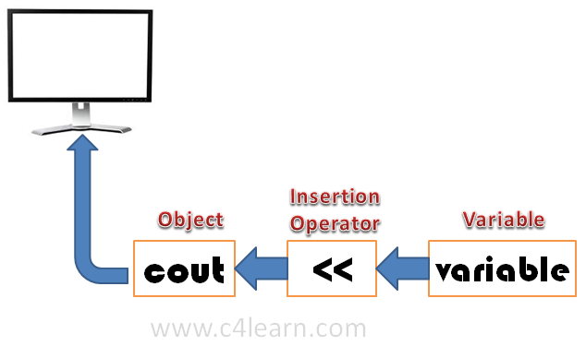
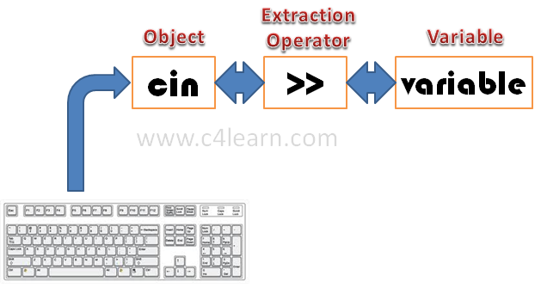
Input and output operations
cin | standard input stream
cout | standard output stream

Slide 24
binary operators
While overloading binary operators, the left-hand operand calls the operator function and the right-hand operator is used as argument.
The friend functions can be used alternatively with member functions for overloading of binary operators. The friend function requires two operands to be passed as arguments.
The binary operators take two arguments .
Frequently used binary operators are addition (+) operator, subtraction (-) operator and division (/) operator , multiplication (*) etc..

Slide 25
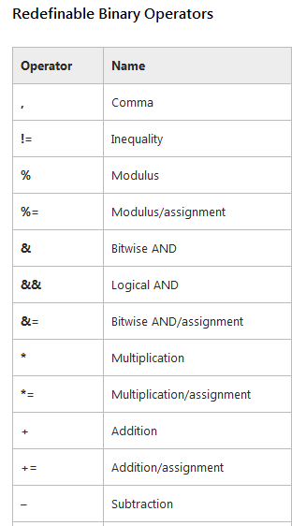
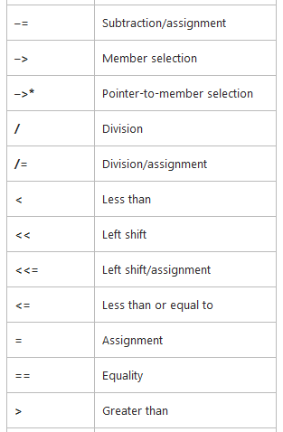
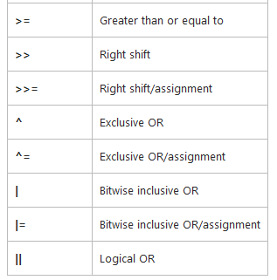
The following table shows a list of operators that can be overloaded.

Slide 26
Advantage..
A statement like c = sum(a,b) can be replaced by a natural looking expression ,
c = a+b; by overloading the + operator using an operator+() function

Slide 27
Binary operator overloading eg:- ( As member function )- To add two complex numbers
class overloading
{
int a,b;
public:
void setValue(int p,int q)
{ a =p;
b =q;
}
overloading operator+(overloading ob)
{
overloading t;
t.a=a+ob.a;
t.b=b+ob.b;
return(t);
}
void display()
{
cout<<a<<"+"<<b<<"i"<<endl;
} };
int main()
{
overloading obj1,obj2,result;
int a,b;
cout<<"Enter the value of first Complex Number :";
cin>>a>>b;
obj1.setValue(a,b);
cout<<"Enter the value of second Complex Number :";
cin>>a>>b;
obj2.setValue(a,b);
result = obj1+obj2;
cout<<"Input Values:\n";
obj1.display();
obj2.display();
cout<<"Result:";
result.display();
}

Slide 28
Previous pgm – Using friend
class overloading
{
int a,b;
public:
void setValue(int p,int q)
{ a =p;
b =q;
}
friend overloading operator+(overloading ob1,overloading ob2);
void display()
{
cout<<a<<"+"<<b<<"i"<<endl;
} };
overloading operator+(overloading ob1,overloading ob2)
{
overloading t;
t.a=ob1.a+ob2.a;
t.b=ob1.b+ob2.b;
return(t);
}
int main()
{
overloading obj1,obj2,result;
int a,b;
cout<<"Enter the value of first Complex Number :";
cin>>a>>b;
obj1.setValue(a,b);
cout<<"Enter the value of second Complex No :";
cin>>a>>b;
obj2.setValue(a,b);
result = obj1+obj2;
cout<<"Input Values:\n";
obj1.display();
obj2.display();
cout<<"Result:";
result.display();
}

Slide 29
Sample questions
1 . Write a menu driven program to add / subtract two 2nd degree polynomials , to multiply a polynomial with a constant number.
2. Using the concept of friend and operator overloading, WAP to compare two string values.

Slide 30
Qn: To add and subtract two complex numbers ( Continued in the next 3 slides)
class complex
{ int a,b;
public:
void getvalue()
{
cout<<"Enter the value of Complex Numbers a,b:";
cin>>a>>b;
}
complex operator+(complex ob)
{ complex t;
t.a=a+ob.a;
t.b=b+ob.b;
return(t);
}
complex operator-(complex ob)
{ complex t;
t.a=a-ob.a;
t.b=b-ob.b;
return(t);
}
void display()
{
cout<<a<<"+"<<b<<"i"<<"\n";
} };
int main()
{
complex obj1,obj2,result,result1;
obj1.getvalue();
obj2.getvalue();
result = obj1+obj2;
result1=obj1-obj2;
cout<<"Input Values:\n";
obj1.display();
obj2.display();
cout<<"Result:";
result.display();
result1.display();
}

Slide 31
void my_string::display()
{
cout<<"\n"<<str;
}
void my_string::operator== (my_string str1)
{
strcpy(str1.str,str);
cout<<"\n\tCopied String is : "<<str1.str;
}
int my_string::operator= (my_string str1)
{
if(strcmp(str,str1.str)==0)
return 1; //strings are equal
return 0; //strings are not equal
}
void my_string::operator+ (my_string str1)
{
strcat(str,str1.str);
cout<<"\n\t--String After Concat is : "<<str;
}
class my_string{
private:
char str[30];
public:
//function declarations
void getdata();
void display();
void operator== (my_string str1);
int operator= (my_string str1);
void operator+ (my_string str1);
void operator<< (my_string str1);
void operator>> (my_string str1);
int operator/ (my_string str1);
void palindrome();
};
void my_string::getdata()
{
cout<<"\nEnter the string : ";
cin>>str;
}

Slide 32
if(str[j]==str1.str[k])
flag=1;
else
{
flag=0;
break;
}
} }
} }
if(flag==0)
return 0; //not a substring
return 1; //it is a substring
}
void my_string::palindrome()
{
int i,j,flag=0;
for(i=0,j=strlen(str)-1;i<=strlen(str),j>=0;j--,i++)
{
if(str[i]!=str[j])
{
flag=1;
cout<<"\n\t--Not a palindrome--";
break;
}
else flag=0;
}
if(flag==0)
cout<<"\n\t--Palindrome--";
}
void my_string::operator<< (my_string str1)
{
cout<<"\n\t--The string you entered is :"<<str1.str;
}
void my_string::operator>> (my_string str1)
{
int i;
cout<<"\n\t--The string after reversing is : ";
for(i=strlen(str1.str);i>=0;i--)
cout<<str1.str[i];
}
int my_string::operator/ (my_string str1)
{
int flag=0,k,i,j,len=strlen(str),len1=strlen(str1.str)-1;
for(i=0;i<len;i++)
{
if(str[i]==str1.str[0])
{
if(str[i+len1]==str1.str[len1])
{
for(j=i,k=0;j<i+len1+1,k<len1;j++,k++)
{

Slide 33
case 4:
a.getdata();
b<<a;
break;
case 5:
a.getdata();
b>>a;
break;
case 6:
a.getdata();
a.palindrome();
break;
case 7:
cout<<"\nEnter the Main string-\n";
a.getdata();
cout<<"\nEnter the other string-\n";
b.getdata();
//operator overloading for finding substring
c=a/b;
if(c==1)
cout<<"\n\t---Substring---\n";
else
cout<<"\n\t---Not a substring---\n";
break;
case 8: return 0;
default: cout<<"Invalid choice..try again\n";
}
if(opt!=8){
cout<<"\n\n\tDo you want to continue(Press 1 to continue)";
cin>>opt1;}
}
return 0;
}
int main()
{
int opt,c,opt1=1;
my_string a,b;
while(opt1==1 && opt!=8)
{
cout<<"\n\t\t\t---Main Menu---\n\t1.Equality\n\t2.String Copy\n\t3.Concat";
cout<<"\n\t4.Display\n\t5.Reverse\n\t6.Palindrome\n\t7.Sub String";
cout<<"\n\t8.Exit\n\t\t--Enter your choice-->";
cin>>opt;
switch(opt)
{
case 1:
cout<<"\nEnter the 1st string-\n";
a.getdata();
cout<<"\nEnter the 2nd string-\n";
b.getdata();
c=a=b;
if(c==1)
cout<<"\n\t---Strings are Equal---\n";
else
cout<<"\n\t---Strings are not Equal---\n";
break;
case 2:
a.getdata();
a==b;
break;
case 3:
cout<<"\nEnter the 1st string-\n";
a.getdata();
cout<<"\nEnter the 2nd string-\n";
b.getdata();
a+b;
break;

Slide 34
Pointers to Objects
A pointer to a C++ class is done exactly the same way as a pointer to a structure and to access members of a pointer to a class , use the member access operator -> operator, just as we do with pointers to structures.
Also as with all pointers, you must initialize the pointer before using it.
Eg: - Box Box1;
Box *ptrBox;
ptrBox = &Box1;
ptrBox->Volume() is same as Box1.volume();
Which is same as (*ptrBox).volume();

Slide 35
Sample program
class Box {
public:
Box(double l=2.0, double b=2.0, double h=2.0)
{
cout <<"Constructor called." << endl;
length = l; breadth = b; height = h;
}
double Volume()
{
return length * breadth * height;
}
private:
double length; // Length of a box
double breadth; // Breadth of a box
double height; // Height of a box
};
int main()
{
Box Box1(3.3, 1.2, 1.5); // Declare box1
Box Box2(8.5, 6.0, 2.0); // Declare box2
Box *ptrBox;
ptrBox = &Box1;
cout << "Volume of Box1: “
<< ptrBox->Volume() << endl;
ptrBox = &Box2;
cout << "Volume of Box2: "
<< ptrBox->Volume() << endl;
return 0;
}

Slide 36
Run time poly ..Eg:- 1 ( without virtual concept)
int Square(int x)
{ return x*x; }
int Cube(int x)
{ return x*x*x; }
int main()
{
int choice;
cout << "Enter 0 for square value, 1 for cube value: ";
cin >> choice;
int (*ptr) (int);
switch (choice)
{
case 0: ptr = Square; break;
case 1: ptr = Cube; break;
} cout << "The result is: " << ptr(5) << endl;
return 0; }
Note: -
void (*func )(int); In this example, func is a pointer to a function taking one argument, an integer, and that returns void.
int (*ptr) (int) is a pointer to a function ptr that takes an integer value as argument and returns integer value.

Slide 37
Pointers to derived classes
Pointers to objects of base class are type compatible with pointers to objects of derived class.
Hence a single pointer can be made to point to all the derived class objects.
baseptr = & derivedob;
This is perfectly valid in C++ since derivedob is a derived class object of base class.
But using this pointer, the original members of derived cannot be accessed, since baseptr points only to the members derived from base class

Slide 38
Example program – To find the area
class Polygon {
protected:
int width, height;
public:
void set_values (int a, int b)
{ width=a; height=b; }
virtual int area ()
{ return 0; }
};
class Rectangle: public Polygon {
public:
int area ()
{ return width * height; }
};
class Triangle: public Polygon {
public:
int area ()
{ return (width * height / 2); }
};
int main () {
Rectangle rect;
Triangle trgl;
Polygon poly;
Polygon * ppoly1 = &rect;
Polygon * ppoly2 = &trgl;
Polygon * ppoly3 = &poly;
ppoly1->set_values (4,5);
ppoly2->set_values (4,5);
ppoly3->set_values (4,5);
cout << ppoly1->area() << '\n';
cout << ppoly2->area() << '\n';
cout << ppoly3->area() << '\n';
return 0;
}

Slide 39
Run time polymorphism
A virtual function is a member function that is declared within a base class and can be redefined by a derived class.
To create virtual function, precede the function’s declaration in the base class with the keyword virtual.
When a class containing virtual function is inherited, the derived class redefines the virtual function to suit its own needs.
Base class pointer can be made to point to derived class object.
In Late Binding function call is resolved at runtime. Hence, now compiler determines the type of object at runtime, and then binds the function call.
Late Binding is also called Dynamic Binding or Runtime Binding.

Slide 40
Run time polymorphism
Polymorphism is also achieved in C++ using virtual functions.
If a function with same name exists in base as well as parent class, then the pointer to the base class would call the functions associated only with the base class.
However, if the function is made virtual and the base pointer is initialized with the address of the derived class, then the function in the child class would be called.

Slide 41
Run time poly ..Eg:- 2
#include <iostream>
using namespace std;
class A
{
int a;
public:
A()
{
a = 1;
}
virtual void show()
{
cout <<a;
}
};
class B: public A
{
int b;
public:
B()
{
b = 2;
}
void show()
{
cout <<b;
}
};
int main()
{
A *pA;
B oB;
pA = &oB;
pA->show();
return 0;
}

Slide 42
Output of previous program under different scenarios..
Previous program - 2
Without keyword virtual - 1
No overriding - 1
Pointer of base when pointed to base object – 1
Pointer of derived when pointed to derived object – 2
Pointer of derived when pointed to base object – [Error] invalid conversion

Slide 43
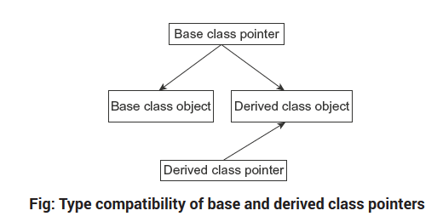
To summarize..

Slide 44
Polymorphism refers to the property by which objects of different classes are able to respond to the same message in different forms.
A pointer, when it is declared as type base, always points to the function in base class.
Ie, the compiler simply ignores the contents of the pointer and chooses the member function that matches the type of pointer.
When the function in base class is declared as virtual, C++ determines which function to use at runtime based on the type of object pointed to by the base pointer, rather than the type of pointer.

Slide 45
Run time polymorphism is achieved only when a virtual function is accessed through a pointer to base class.

Slide 46
Rules for virtual function
Virtual functions must be members of class
They must not be static.
They are accessed by using object pointers.
A virtual function can be a friend of another class.
Even though its not used, the virtual function must be defined in base class.
The reverse of virtual concept is not true, we cannot make a derived object pointer access the base.
Incrementing /decrementing the pointer will never point to the next derived object of this base class.
If a virtual function is not defined in derived class, then the base class function will be invoked.

Slide 47
Pure virtual function
Pure virtual Functions are virtual functions with no definition.
They start with virtual keyword and ends with = 0.
Here is the syntax for a pure virtual function,
virtual void f() = 0;
A pure virtual function can be indicated by using a pure specifier (= 0) in the declaration of a virtual member function in the class declaration.
Now the compiler requires each derived class to either define the function or
re-declare it as pure virtual.

Slide 48
Example..
class Test
{
// Data members of class
public:
// Pure Virtual Function
virtual void show() = 0;
/* Other members */
};

Slide 49
An example..
class Base
{
int x;
public:
virtual void fun() = 0;
int getX() { return x; }
};
// This class inherits from Base and implements fun()
class Derived: public Base
{
int y;
public:
void fun() { cout << "fun() called"; }
};
int main(void)
{
Derived d;
d.fun();
return 0;
}

Slide 50
Abstract Classes
It is a class which is not used to create objects.
It is designed only to act as base class which provides an interface for its sub classes.
It is a design concept in program development and provides a base upon which other classes can be built.
A class is made abstract by declaring at least one of its functions as pure virtual function.
Classes inheriting an Abstract Class must provide definition to the pure virtual function, otherwise they will also become abstract class.

Slide 51
Characteristics of Abstract Class
Abstract class cannot be instantiated, but pointers and references of Abstract class type can be created.
Abstract class can have normal functions and variables along with a pure virtual function.
Classes inheriting an Abstract Class must implement all pure virtual functions, or else they will become Abstract too.

Slide 52
Example: -
class Base //Abstract base class
{
public: virtual void show() = 0; //Pure Virtual Function
};
class Derived:public Base
{
public: void show()
{
cout << "Implementation of Virtual Function in Derived class";
} };
int main()
{
Base obj; //Compile Time Error
Base *b;
Derived d;
b = &d;
b->show();
}
Output : Implementation of Virtual Function in Derived class

Slide 53
Applications of Abstract class
An object-oriented system might use an abstract base class to provide a common and standardized interface for all its derived classes.
The purpose of an abstract class is to define a common protocol for a set of concrete subclasses. This is useful when defining objects that share code.
There is a guarantee that all of its children will have this same function commonly implemented.
Now, using a pointer of type base, the functions in derived classes can be accessed.

